Slide 1

Sharadchandra Pawar College of Engineering and Technology, Someshwarnagar
Department of Computer Engineering
A
Project Presentation
on
“Movie Recommendation System”
Presented by:
Avdhut Durgade (CO-313)
Shrutika Gadekar (CO-314)
Guide Name:
Mrs. Sarika Pawar

Slide 2
CONTENTS
Introduction
Aim & Objectives
Literature Survey
Scope of the project
Machine Learning Library
Preferred Technology
Scikit-Learn library
System Architecture
Module Description
Applications
Conclusion

Slide 3
Introduction
Recommendation systems help users find and select items (e.g. Movies)from the huge number available on the web
Given a large set of items and a description of the users needs, they present to the user a small set of the items that are well suited to the description. Similarly, a movie recommendation system provides a level of comfort and personalization that helps the user interact better with the system and watch movies that.
The purpose of a recommendation system basically is to search for content that would be interesting to an individual.

Slide 4
Aim and Objective
Aim:-
The aim of this project is to find a set of non-dominated items and make recommendations based that small set of data and compare it with recommendations based on the entire dataset.
Objective:-
To create a Collaborative Filtering based Movie Recommendation System
Predict the rating that a user would give to a movie that he has not yet rated
Minimize the difference between predicted and actual rating .

Slide 5
LITERATURE SURVEY
Sr. No. | Title of the paper | Description with seed idea | Technique used | Merit/Demerits
1 | “Movie Recommendation System”. | We have studies about daily Recommender System , Machine Learning, Collaborative filtering , content based filtering. | Calculation of the cosine similarity matrix which is done using the movies feature vectors and the users. | Merit: Movies area until a supply of standard diversion. from the instant we have a tendency to derive pleasure observance a moving picture. Demerits: There is no denying that movies nowdays area unit additional violent than ever before.

Slide 6
Scope of the project
Recommender system are information filtering tools that aspire to predict the rating for users and items.
Predominantly from big data to recommend their movie recommendations systems provide a mechanisms to assist users in classifying users with similar.
Currently the industry is trying to integrate various advanced recommender.

Slide 7
Preferred Technology
Machine Learning Library
Pandas
Numpy
Sklearn
Scikit-Learn library
For User Interface: python , Jupyter notebook
For Backend: Machine learning
For Implementation : AWS/GCP/Azure

Slide 8
Scikit-Learn library
Scikit-Learn is a free machine learning library for Python.
Supports both supervised and unsupervised machine learning
Algorithms for classification, regression, clustering, and dimensionality reduction.
licensed under a permissive simplified BSD license
Distributed under many Linux distributions, encouraging academic and commercial use.
library is built upon the SciPy (Scientific Python) that must be installed before you can use scikit-learn

Slide 9
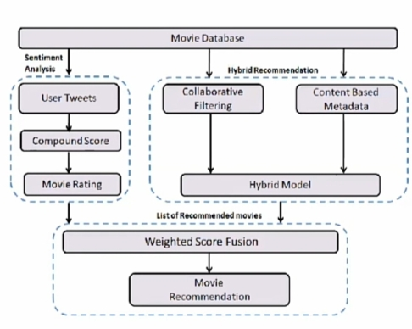
SYSTEM ARCHITECTURE

Slide 10
Module Description
Modules:
Content Based Filtering
Collaborative Filtering
Content Based Filtering:
The Content based recommender relies on the similarity of the items being recommended.
Collaborative Filtering:
The Collaborative Filtering Recommender is entirely based on the past behavior and not on the context.

Slide 11
Applications
Work on several numbers of data: the numbers of choices for anything on internet is very high and it’s tedious to refine most wanted data by self while searching . the scope of this proposal system includes working within numerous data , with ease.
Saving of time: Many people have problem selecting the alternative item of movie due to lack of time and due to search issues.

Slide 12
Conclusions
With the enormous number of movies releasing worldwide every year, people often miss out on some amazing work of arts due to the lack of correct suggestion.
Putting machine learning based Recommendation systems into work is thus very important to get the right recommendations
We saw content-based recommendation systems that although may not seem very effective on its own, but when combined with collaborative techniques can solve the cold start problems that collaborative filtering methods face when run independently

Slide 13
Thank You…..

